Slide 1
Biomimicry and Bats!
©Science Delivered 2019

Slide 2
NGSS Alignment These slides address standard 1-LS1-1 Use materials to design a solution to a human problem by mimicking how plants and/or animals use their external parts to help them survive, grow, and meet their needs. Please see the Teacher’s Key for notes about the information presented here
Go here for more information:
https://ngss.nsta.org/DisplayStandard.aspx?view=pe&id=49
©Science Delivered 2019

Slide 3
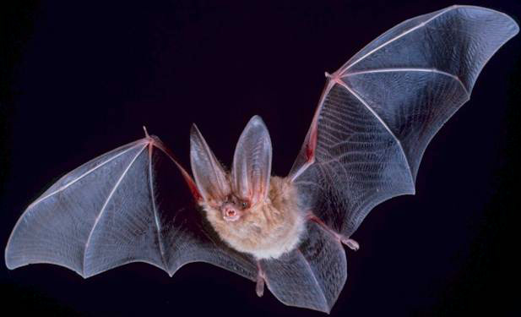
Presentation Outline
Before Starting: Learn about bats and sound
Kickoff discussion: Can bats inspire inventions that help humans?
Lesson 1: Echolocation
Lesson 2: Echolocation inspired-inventions
Lesson 3: Robo-bat, bats inspire improved flying machines!
Lesson 4: Students create bat-invention! (Includes review of bat features)
ANY DAY – Meet a bat scientist, Kristen Lear
©Science Delivered 2019

Slide 4
Kickoff Discussion
Can bats inspire inventions that help humans?
©Science Delivered 2019

Slide 5
Question: Can understanding BATS’ bodies and behaviors
help us build things to help people???
Discuss as a class
?
By PD-USGov, exact author unknown - https://www.nps.gov/chis/learn/nature/townsends-bats.htm, Public Domain, https://commons.wikimedia.org/w/index.php?curid=192812; man By Videoplasty.com, CC BY-SA 4.0, https://commons.wikimedia.org/w/index.php?curid=67046661
©Science Delivered 2019

Slide 6
Let’s learn more about bats to help us think about whether bats can inspire inventions that can help people.
By PD-USGov, exact author unknown - https://www.nps.gov/chis/learn/nature/townsends-bats.htm, Public Domain, https://commons.wikimedia.org/w/index.php?curid=192812;
©Science Delivered 2019

Slide 7
Lesson ONE
Echolocation
©Science Delivered 2019

Slide 8
Some people say bats are blind,
but that’s not true. They CAN see.
eye
By Uwe Schmidt - File:Desmo-scan.tif and File:Desmo-boden.tif, CC BY-SA 4.0, https://commons.wikimedia.org/w/index.php?curid=60427939
©Science Delivered 2019

Slide 9
BUT bats fly around at night.
It’s hard to see in the dark.
Can you see in the dark?
By PD-USGov, exact author unknown - https://www.nps.gov/chis/learn/nature/townsends-bats.htm, Public Domain, https://commons.wikimedia.org/w/index.php?curid=192812
©Science Delivered 2019
Notes:
Refer back to lessons where students learned about how you need light to see.

Slide 10
Many bats use a special way to get
around and find food in the dark…
What is it???
By PD-USGov, exact author unknown - https://www.nps.gov/chis/learn/nature/townsends-bats.htm, Public Domain, https://commons.wikimedia.org/w/index.php?curid=192812
©Science Delivered 2019
Notes:
Refer back to lessons where students learned about how you need light to see.

Slide 11
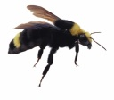
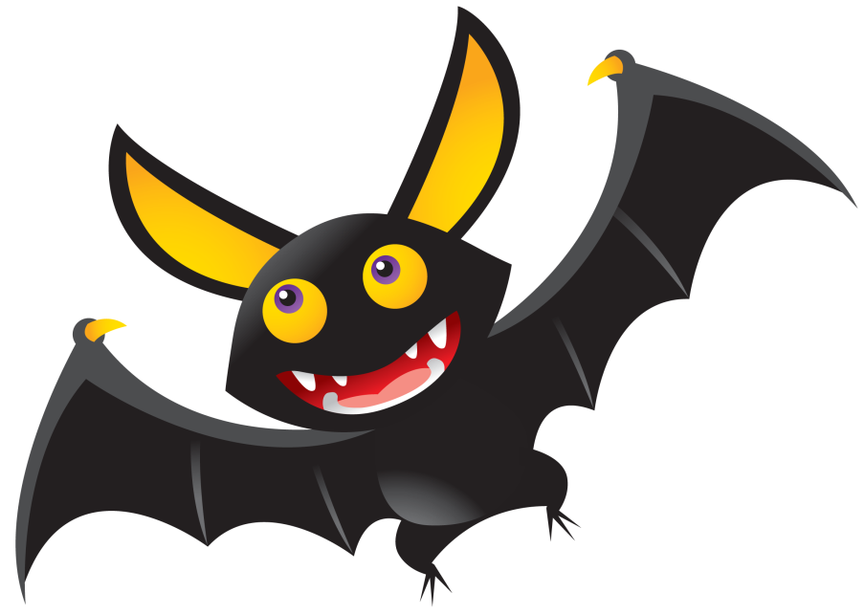
Bats get around in the dark using…
Echolocation!
Bats make sounds with their mouths that bounce off things or “echo”.
This helps them know where things are in the dark!
http://clipart-library.com/clipart/239667.htm
©Science Delivered 2019

Slide 12
Breaking Down ECHOLOCATION
1. Sounds come from the bat’s MOUTH.
2. The sounds hits an object (here, a fly).
3. The sounds echo back to the bat’s EARS.
4. From this sound echo, the bat knows the location of the object!
Discuss as a class!
http://clipart-library.com/clipart/239667.htm
©Science Delivered 2019

Slide 13
ECHOLOCATION VIDEO 1
Echolocation Explainer: “Bat Echolocation” by Incredible Bats
Discuss what you learned!
(If link above doesn’t work, copy and paste this link:
https://www.youtube.com/watch?time_continue=86&v=kp5jyZtoTIg&feature=emb_logo)
©Science Delivered 2019
Notes:
There is a video about research on bat echolocation here. It is way advanced for first graders but does have a lot of (slowed down and enhanced) echolocation sounds

Slide 14
ECHOLOCATION VIDEO 2
Cartoon Video: Jumpstart Bat Echolocation Song
Discuss what you learned!
(If link above doesn’t work, copy and paste this link:
https://www.youtube.com/watch?v=Hr-Y2Tt8gFE
or google “Jumpstart Bat Echolocation”)
©Science Delivered 2019

Slide 15
Lesson TWO
Bat and Echolocation-Inspired Inventions
©Science Delivered 2019
Notes:
First review echolocation

Slide 16
Can understanding
bat echolocation help humans?
Bats use echolocation to function in the dark.
Can what we know about echolocation be used to help people who are blind?
http://clipart-library.com/clipart/239667.htm
©Science Delivered 2019

Slide 17
The Question:
Can knowing about echolocation help us build better devices to help people with limited sight?
This Photo by Unknown Author is licensed under CC BY-SA

Slide 18
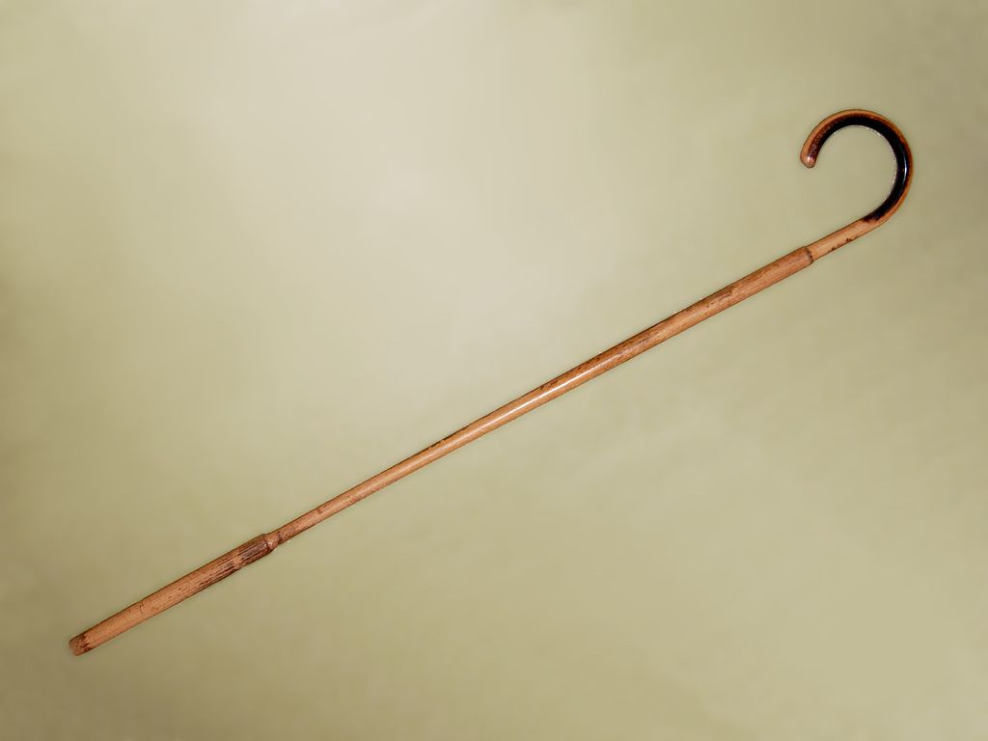
Many blind people use canes
Can a CANE echolocate???
Can a watch?
Notes:
Some good articles and videos about the echolocating cane:
https://www.mnn.com/health/fitness-well-being/blogs/smart-cane-uses-echolocation-to-guide-the-blind
https://www.nature.com/news/2003/030915/full/news030908-2.html
Image from: https://www.dailymail.co.uk/sciencetech/article-2663715/The-white-stick-gets-21st-century-makeover-30-smart-cane-uses-SONAR-vibrations-help-blind-people-see.html

Slide 19
What would a cane have to do to echolocate? Discuss!
Notes:
To echolocate, bats must make a sound, and be able to detect an echo. Can a cane make a sound and detect an echo?

Slide 20
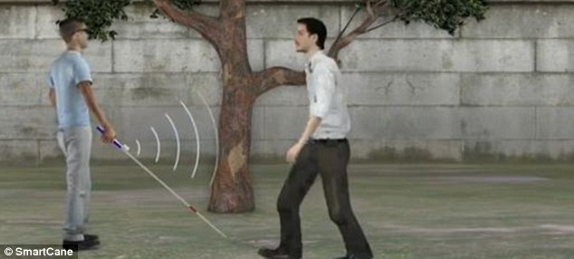
There IS an Echolocating Cane!
The cane mimics bat echolocation to help people who are blind to get around!
Notes:
Some good articles and videos about the echolocating cane:
https://www.mnn.com/health/fitness-well-being/blogs/smart-cane-uses-echolocation-to-guide-the-blind
https://www.nature.com/news/2003/030915/full/news030908-2.html
Image from: https://www.dailymail.co.uk/sciencetech/article-2663715/The-white-stick-gets-21st-century-makeover-30-smart-cane-uses-SONAR-vibrations-help-blind-people-see.html

Slide 21
More About the Echolocating Cane
The cane sends off signals and “vibrates” when something is in front of it.
Then the person knows to avoid the object!
Notes:
Some good articles and videos about the echolocating cane:
https://www.mnn.com/health/fitness-well-being/blogs/smart-cane-uses-echolocation-to-guide-the-blind
https://www.nature.com/news/2003/030915/full/news030908-2.html
Image from: https://www.dailymail.co.uk/sciencetech/article-2663715/The-white-stick-gets-21st-century-makeover-30-smart-cane-uses-SONAR-vibrations-help-blind-people-see.html

Slide 22
Echolocating watch!
Watch this video to learn about a watch inspired by echolocation!
(Device Helps Blind 'See' Like a Bat” from Associated Press)
This helps people who are blind navigate in a way similar to bats!
(If link above doesn’t work, copy and paste this link:
“https://www.youtube.com/watch?v=SUGFZH9EVDA”)
Notes:
Some good articles and videos about the echolocating cane:
https://www.mnn.com/health/fitness-well-being/blogs/smart-cane-uses-echolocation-to-guide-the-blind
https://www.nature.com/news/2003/030915/full/news030908-2.html
Image from: https://www.dailymail.co.uk/sciencetech/article-2663715/The-white-stick-gets-21st-century-makeover-30-smart-cane-uses-SONAR-vibrations-help-blind-people-see.html

Slide 23
Lesson THREE
Another Bat-inspired Invention: Robo-bat
©Science Delivered 2019
Notes:
First review echolocation

Slide 24
People have been inspired by bats in other ways too!
©Science Delivered 2019

Slide 25
What else is special about bats that might inspire people?
©Science Delivered 2019

Slide 26
First of all, bats can fly
wings
By PD-USGov, exact author unknown - https://www.nps.gov/chis/learn/nature/townsends-bats.htm, Public Domain, https://commons.wikimedia.org/w/index.php?curid=192812
©Science Delivered 2019

Slide 27
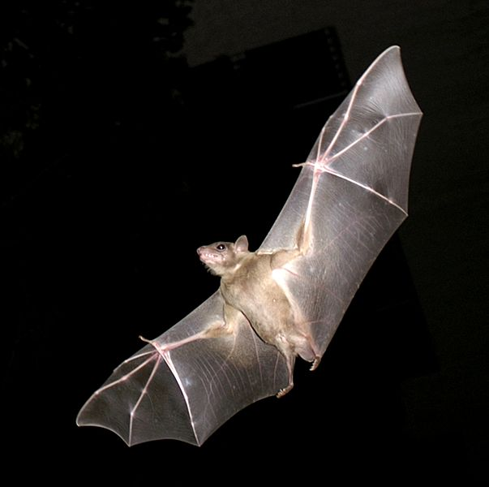
And they have unique wings
Flexible wings mean bats can switch directions easily while flying!
By Original photo: אורן פלס Oren PelesDerivative work: User:MathKnight - File:PikiWiki Israel 11327 Wildlife and Plants of Israel.JPG by אורן פלס, CC BY 2.5, https://commons.wikimedia.org/w/index.php?curid=27775788
©Science Delivered 2019

Slide 28
Are bat wings different than the wings of other animals? Discuss as a class.
Notes:
To echolocate, bats must make a sound, and be able to detect an echo. Can a cane make a sound and detect an echo?

Slide 29
Example: Bat wings
are different than bird wings
Bat wings use less energy than bird wings
Bat wing
Bird wing
By Original photo: אורן פלס Oren PelesDerivative work: User:MathKnight - File:PikiWiki Israel 11327 Wildlife and Plants of Israel.JPG by אורן פלס, CC BY 2.5, https://commons.wikimedia.org/w/index.php?curid=27775788 bird wing: By Toby Hudson - Own work, CC BY-SA 3.0, https://commons.wikimedia.org/w/index.php?curid=8267094. Both images are cropped
©Science Delivered 2019

Slide 30
Bats have unique wings
See a video of bat wings here!
Video is called: “Bats take flight” from Science Friday
Link to copy and paste: https://www.youtube.com/watch?v=BNNAxCuaYoc
©Science Delivered 2019

Slide 31
Student Activity: Compare Bat vs. Bird Wings!
©Science Delivered 2019
Notes:
This student handout is provided

Slide 32
A Question:
Can we mimic bats unique wings to make a helpful invention?

Slide 33
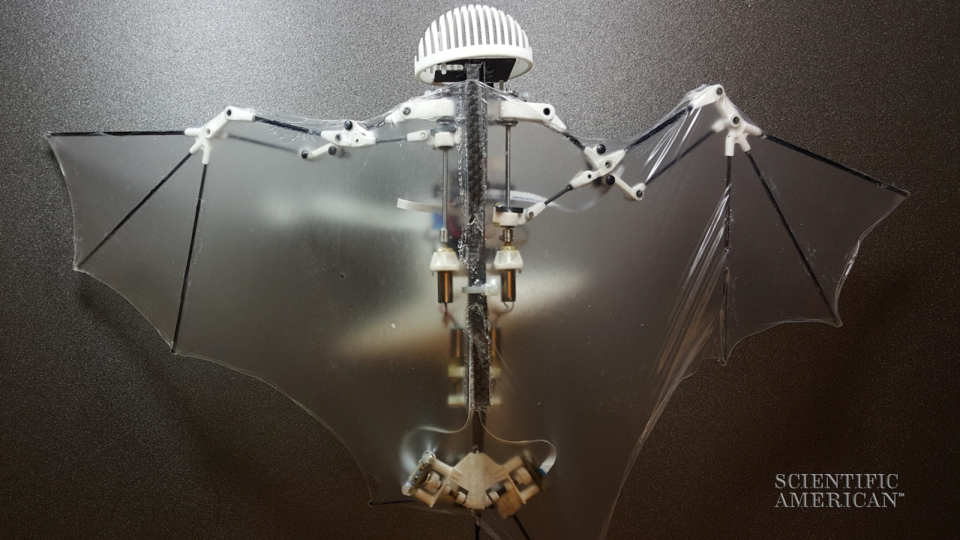
Introducing … the Robo-Bat!
Notes:
Cool video of the Bat Bot flying:
https://www.youtube.com/watch?v=QyuWbNrX3v4
Articles:
https://www.caltech.edu/about/news/engineers-build-robot-drone-mimics-bat-flight-53794
https://newatlas.com/robotic-bat-wing-reveals-flight-secrets-of-bats/26381/

Slide 34
Do its wings look like a bat’s wings?
Notes:
Cool video of the Bat Bot flying:
https://www.youtube.com/watch?v=QyuWbNrX3v4
Articles:
https://www.caltech.edu/about/news/engineers-build-robot-drone-mimics-bat-flight-53794
https://newatlas.com/robotic-bat-wing-reveals-flight-secrets-of-bats/26381/

Slide 35
Watch the Robo-Bat fly! Video 1
See a video of Robo-Bat here!
Called “Robo-bat Flaps Like a Real Thing” by Scientific American. Link https://www.youtube.com/watch?v=QyuWbNrX3v4
Video from Scientific American: https://www.youtube.com/watch?v=QyuWbNrX3v4
©Science Delivered 2019

Slide 36
See a Robo- “wing”! Video 2
An older but excellent video, Meet a “Ro-bat” wing here
Called “Meet Ro-Bat, Brown University’s Robotic Wing” Link https://www.youtube.com/watch?v=R1iYXXaKvDE
Video from Scientific American: https://www.youtube.com/watch?v=QyuWbNrX3v4
©Science Delivered 2019

Slide 37
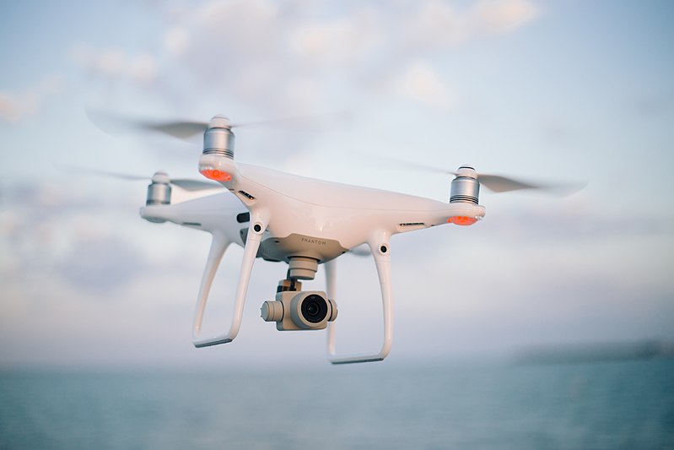
We already have small machines that fly…
drone
https://upload.wikimedia.org/wikipedia/commons/6/6a/Quadcopter_camera_drone_in_flight.jpg

Slide 38
… but our learning about bats helps us build better flying machines!

Slide 39
What can we use the Robo-Bot for?
We can build machines that are safer and use less energy!
These “Bat Bots” can be used in search and rescue missions to help save people
How else could the Robo-Bats be used to either help people, animals, or the environment? Discuss as a class
Notes:
Cool video of the Bat Bot flying:
https://www.youtube.com/watch?v=QyuWbNrX3v4
Article:
https://www.caltech.edu/about/news/engineers-build-robot-drone-mimics-bat-flight-53794

Slide 40
Student Sheet: Compare a real bat to a Robo-bat!
©Science Delivered 2019
Notes:
This student handout is provided

Slide 41
Lesson FOUR
You design an invention inspired by BATS
©Science Delivered 2019
Notes:
Review previous materials and Biomimicry

Slide 42
Biomimicry
Humans often look to nature to solve problems.
When we design things that mimic animals or plants, like the echolocating cane or the Robo-Bat, it is called biomimicry!
©Science Delivered 2019

Slide 43
Biomimicry: Your turn!
You learned about echolocating canes and watches, and the Robo-bat.
Can you think of another way to help people or solve a problem that is inspired by bats?
Do you have an idea for a bat-inspired invention?
©Science Delivered 2019

Slide 44
Biomimicry: What would you make?
To help you get inspired, let’s learn/review information about bats!
©Science Delivered 2019

Slide 45
How do bats survive?
What other body parts and behaviors do bats have to help them survive?
Discuss as a class!
By PD-USGov, exact author unknown - https://www.nps.gov/chis/learn/nature/townsends-bats.htm, Public Domain, https://commons.wikimedia.org/w/index.php?curid=192812
©Science Delivered 2019

Slide 46
Bats have wings!
Wings!
By PD-USGov, exact author unknown - https://www.nps.gov/chis/learn/nature/townsends-bats.htm, Public Domain, https://commons.wikimedia.org/w/index.php?curid=192812
©Science Delivered 2019

Slide 47
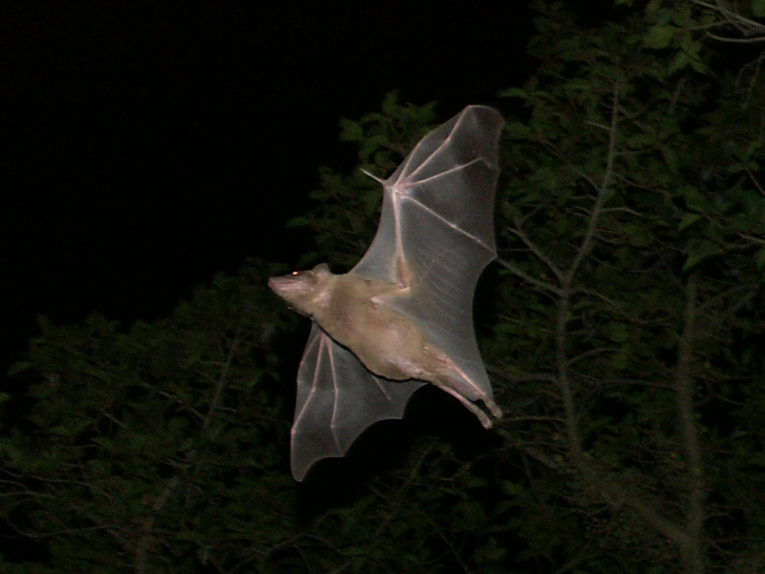
Wings let bats fly!
By Zoharby - Own work, CC BY-SA 3.0, https://commons.wikimedia.org/w/index.php?curid=9203084
©Science Delivered 2019

Slide 48
Bats fly to get from place to
place and to search for food.
This helps them survive.
By Zoharby - Own work, CC BY-SA 3.0, https://commons.wikimedia.org/w/index.php?curid=9203084
©Science Delivered 2019

Slide 49
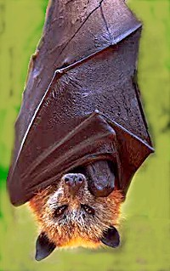
Bat behavior: bats hang upside down!
By The original uploader was Latorilla at English Wikipedia. - Transferred from en.wikipedia to Commons., CC BY-SA 3.0, https://commons.wikimedia.org/w/index.php?curid=2743619
©Science Delivered 2019

Slide 50
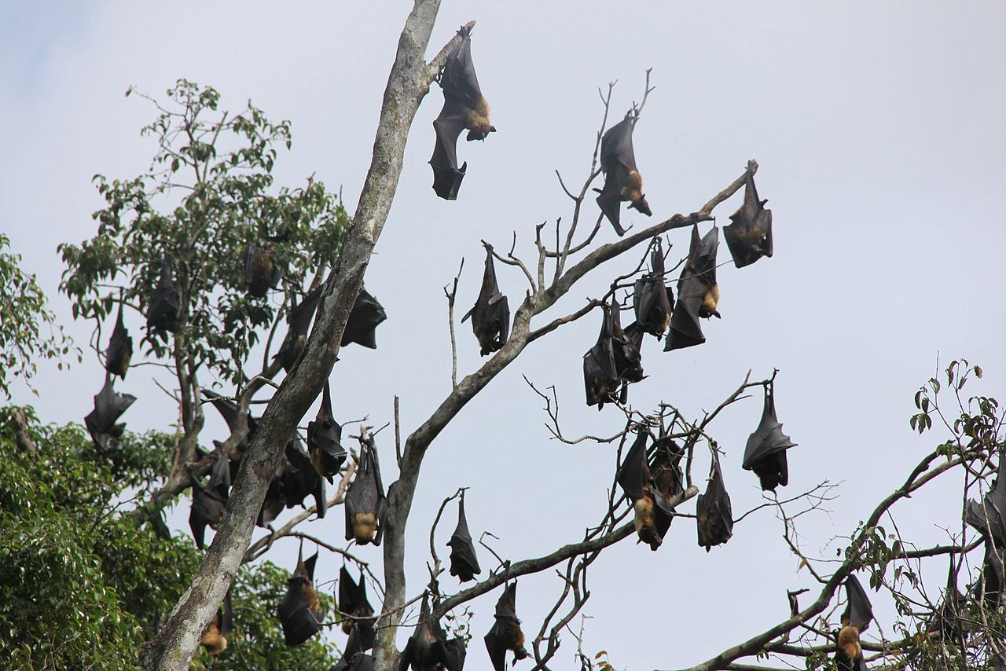
Hanging upside
down lets bats:
1. Sleep in places birds or other
animals don’t (less competition for
sleeping space).
By Peter van der Sluijs - Own work, CC BY-SA 3.0, https://commons.wikimedia.org/w/index.php?curid=26915549
©Science Delivered 2019

Slide 51
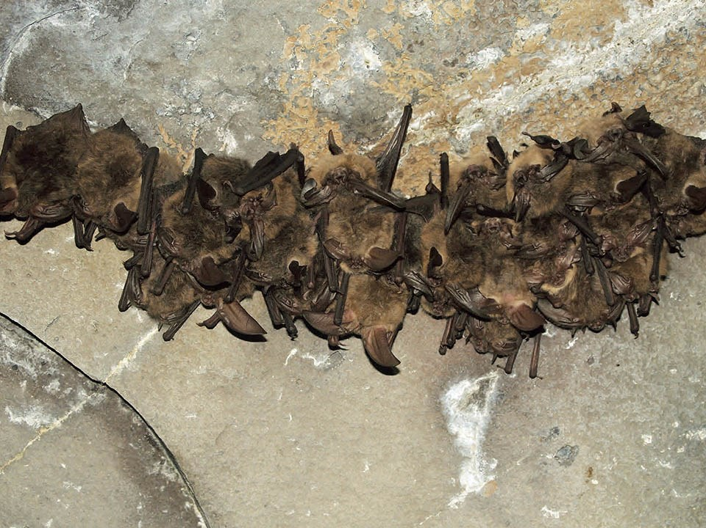
Hanging upside
down lets bats:
2. Sleep or hide in places predators are unlikely to look, like caves!
By The original uploader was Latorilla at English Wikipedia. - Transferred from en.wikipedia to Commons., CC BY-SA 3.0, https://commons.wikimedia.org/w/index.php?curid=2743619
©Science Delivered 2019

Slide 52
Hanging upside
down lets bats:
3. Fly away quickly. Bat bodies can launch most quickly from an upside-down position.
NPS / Shawn Thomas : https://www.nps.gov/articles/bats-bear-gulch-cave.htm
©Science Delivered 2019

Slide 53
Bats also: Sleep in large groups to
stay warm
By The original uploader was Latorilla at English Wikipedia. - Transferred from en.wikipedia to Commons., CC BY-SA 3.0, https://commons.wikimedia.org/w/index.php?curid=2743619
©Science Delivered 2019

Slide 54
Bats fly in large groups to stay
protected from predators
photo credit: USFWS/Ann Froschauer https://www.flickr.com/photos/usfwshq/9413217529
©Science Delivered 2019

Slide 55
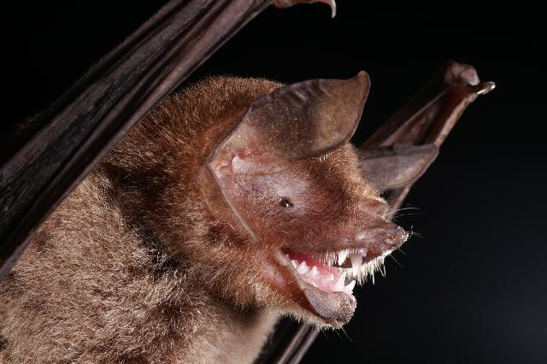
Bats’ sharp teeth help them eat and
defend themselves
By Alex Borisenko, Biodiversity Institute of Ontario - Entry on Pteronotus parnellii at BOLD Systems - Image, CC BY-SA 3.0, https://commons.wikimedia.org/w/index.php?curid=14714088
©Science Delivered 2019

Slide 56
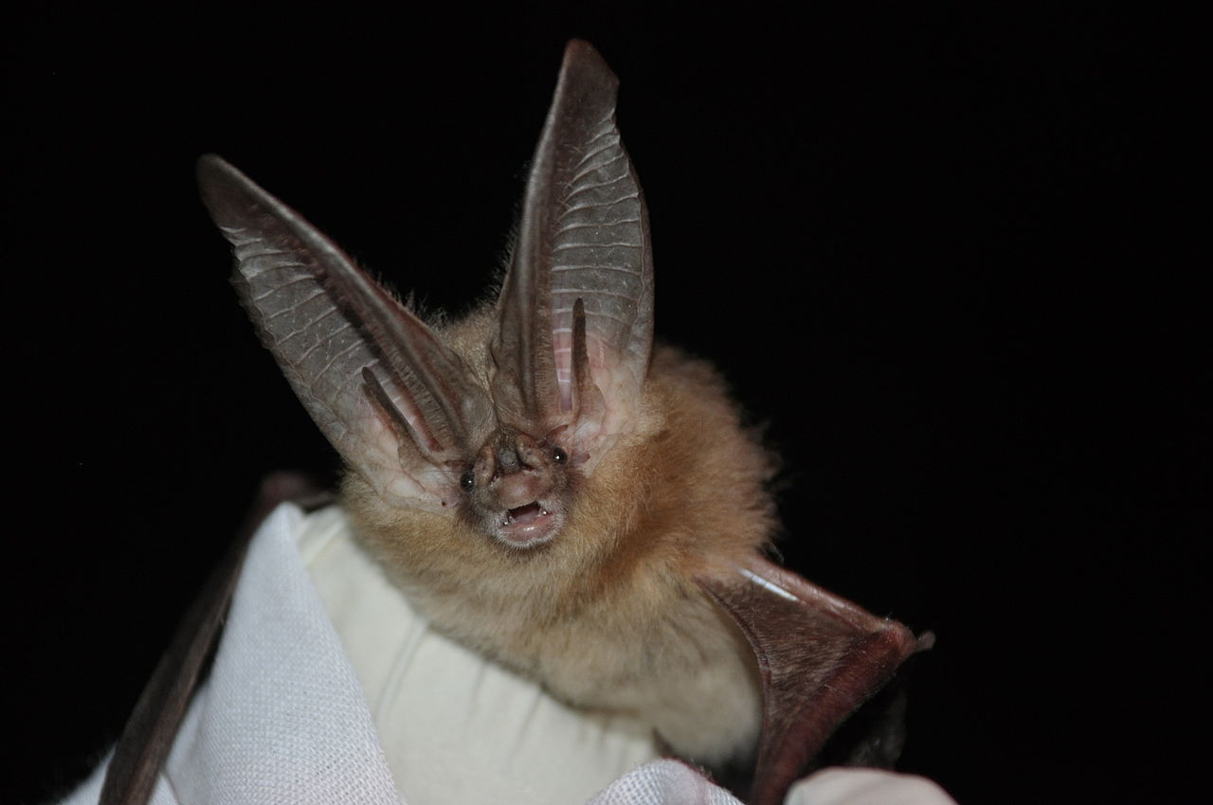
Bats’ big ears help them hear
This is a Townsend’s Big-eared bat
By U.S. Fish and Wildlife Service Headquarters - Townsend's big-eared batUploaded by Dolovis, Public Domain, https://commons.wikimedia.org/w/index.php?curid=31316518
©Science Delivered 2019

Slide 57
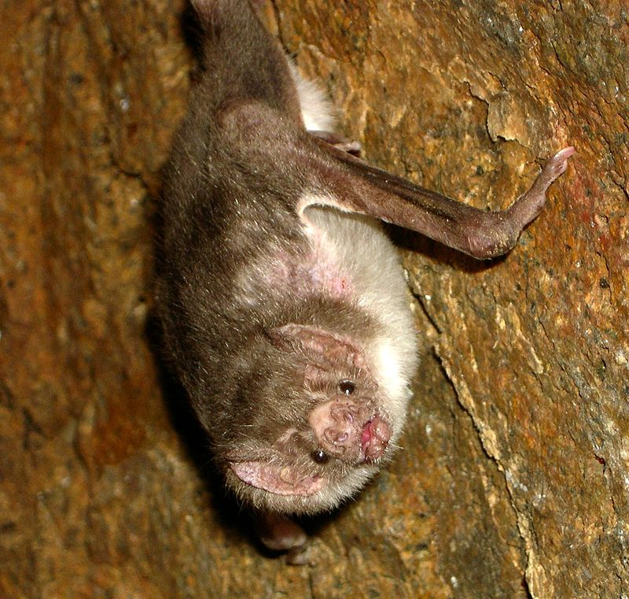
Bats’ fur helps them stay warm
Do you see the fur?
By Acatenazzi at English Wikipedia - Own work by the original uploader, CC BY-SA 3.0, https://commons.wikimedia.org/w/index.php?curid=298052
©Science Delivered 2019

Slide 58
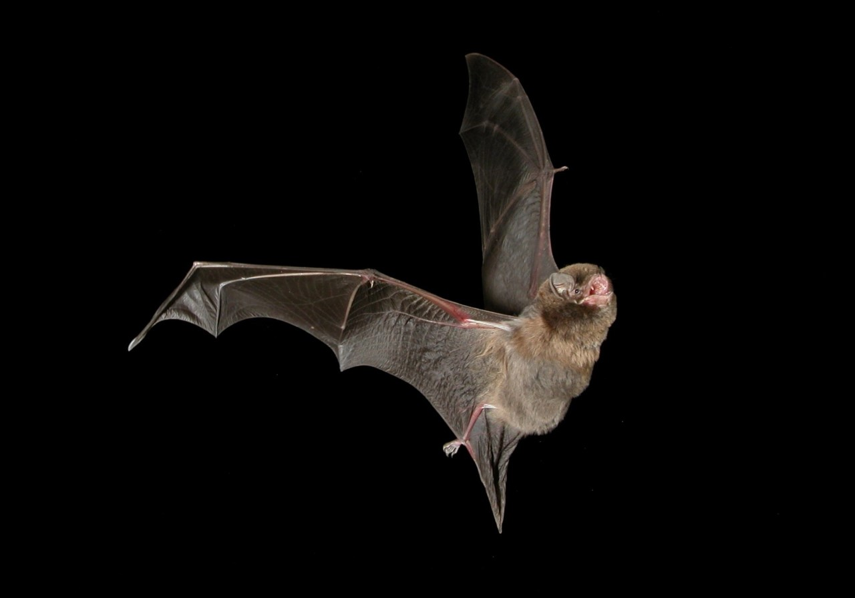
Do bats inspire you?
Steve Bourne [CC BY-SA 4.0 (https://creativecommons.org/licenses/by-sa/4.0)]

Slide 59
Do bats inspire you?
Can you think of your own
invention inspired by bats?
Design one now!

Slide 60
Review! Bats:
Have wings to fly
Have sharp teeth to eat and protect themselves
Have fur to keep warm
Have big ears to hear
Sleep and fly in large groups for protection (flying) and warmth (sleeping)
Sleep upside down (to hide, have good sleeping spots, and to be able to fly away quickly).

Slide 61
Meet a Bat Scientist!
©Science Delivered 2019
Notes:
Review previous materials

Slide 62
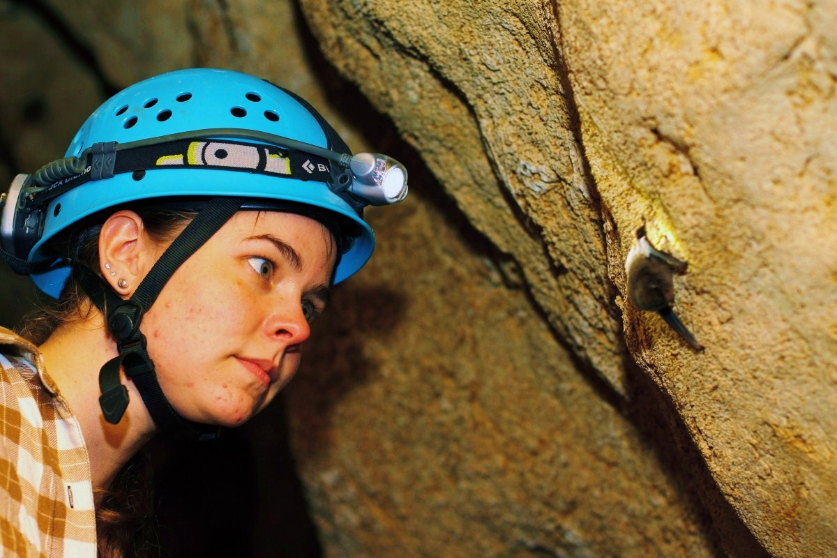
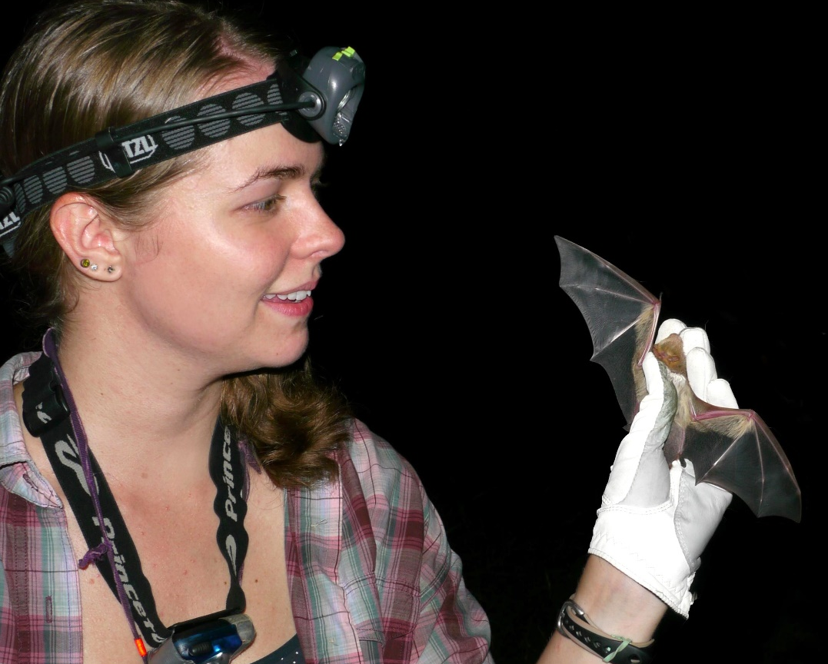
Meet a Bat Scientist!
Kristen Lear
Bat Conservationist
Top photo: Steve Bourne; Bottom photo: Pam Burtt
Notes:
Kristen’s mission is to protect bats around the world! She has worked with bats in the US, Australia, and Mexico, and loves talking to people about bats and how we can protect them.

Slide 63
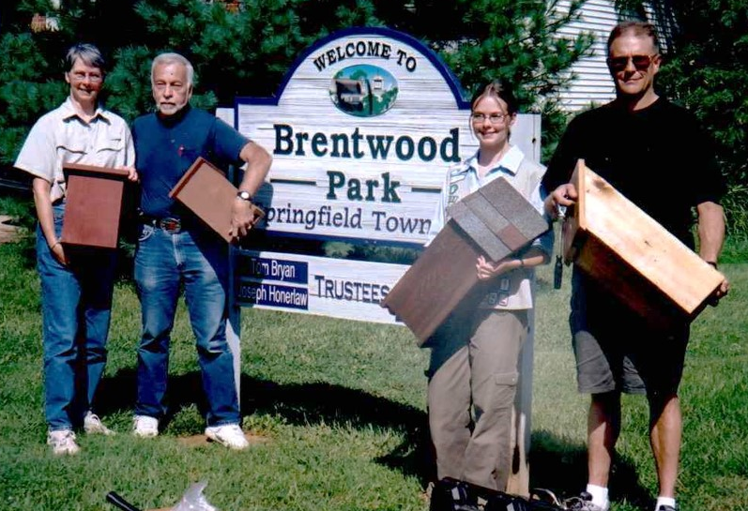
Meet a Bat Scientist!
Kristen building bat houses in 6th grade!
It’s NEVER too early to start!
Photo: Kristen Lear
Notes:
Kristen got her start in bat conservation in 6th grade, when she built and put up bat houses for her Girl Scout Silver Award project. It’s never too early to get involved!
To learn more about Kristen’s work, visit https://kristenlear.wixsite.com/batconservation. To get in touch with her about bats, bat conservation projects, etc., email her at kristen.lear@gmail.com!

Slide 64
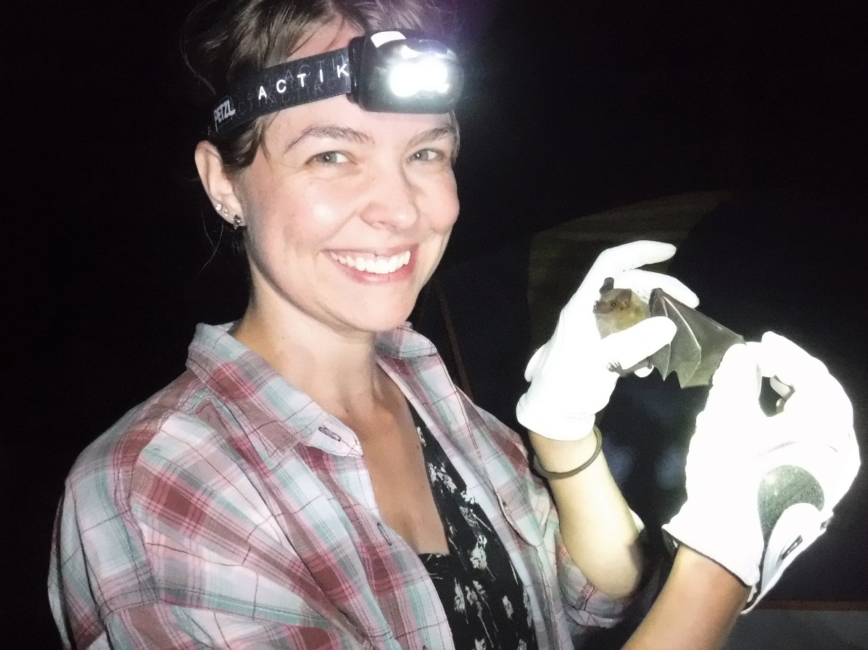
Ms. Lear co-created this lesson!
She thinks YOU would make a great scientist or inventor!
Visit her website here – you can even e-mail her!
Photo: Kristen Lear
Notes:
Kristen got her start in bat conservation in 6th grade, when she built and put up bat houses for her Girl Scout Silver Award project. It’s never too early to get involved!
To learn more about Kristen’s work, visit https://kristenlear.wixsite.com/batconservation. To get in touch with her about bats, bat conservation projects, etc., email her at kristen.lear@gmail.com!

Slide 65
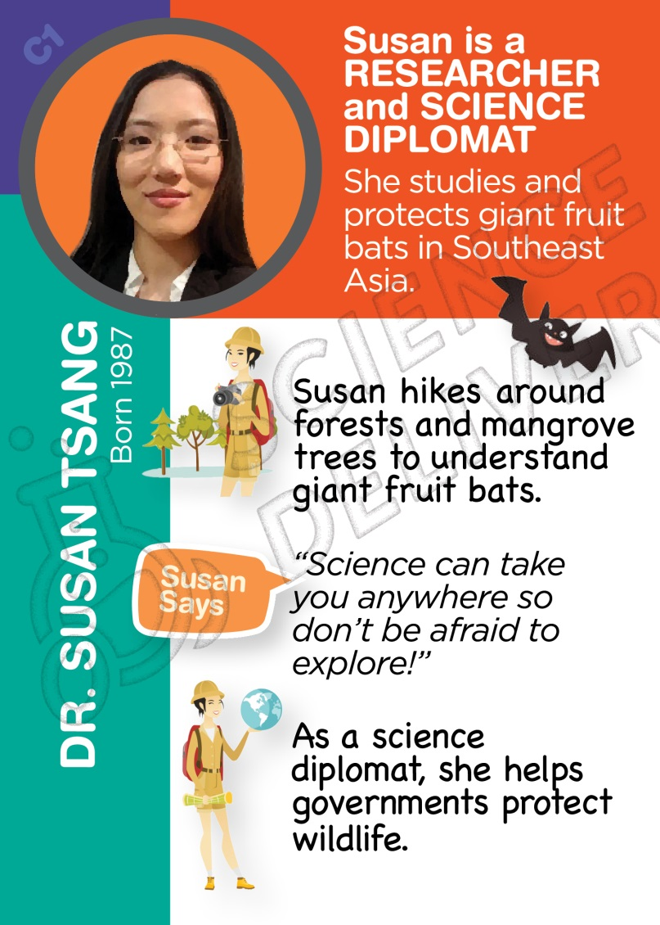
You might also be interested in
learning about Dr. Susan Tsang
Find out more about her at STEMTradingCards.org/dr-susan-tsang
Photo: Kristen Lear

