Slide 1
NGSS: 3-LS4-3 Construct an argument with evidence that in a particular habitat some organisms can survive well, some survive less well, and some cannot survive at all. Clarification Statement: Examples of evidence could include needs and characteristics of the organisms and habitats involved. The organisms and their habitat make up a system in which the parts depend on each other. Go here for more information: http://ngss.nsta.org/DisplayStandard.aspx?view=topic&id=12

Slide 2
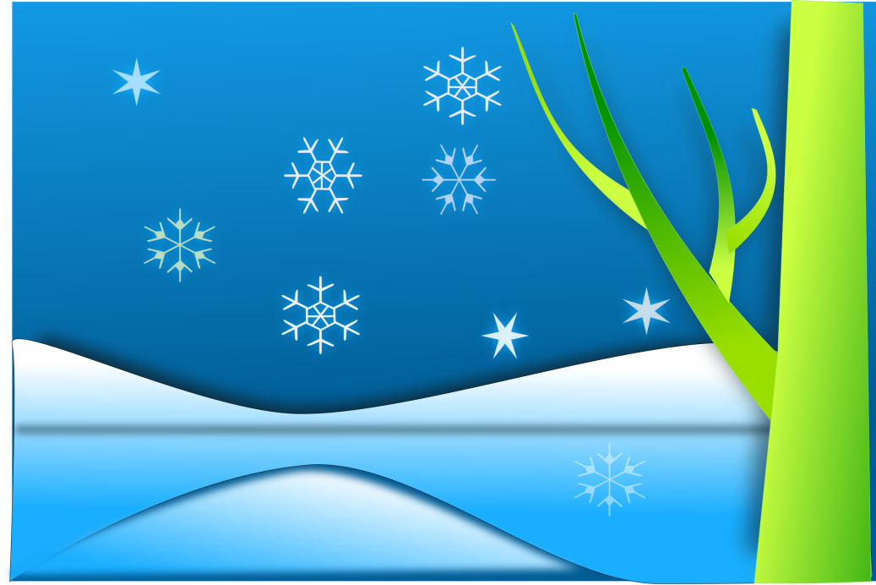
What happens to animals and plants if you put them in different habitats?
Let’s find out!

Slide 3
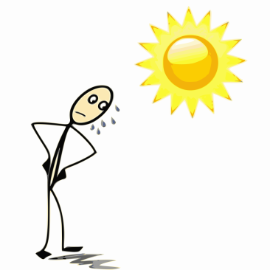
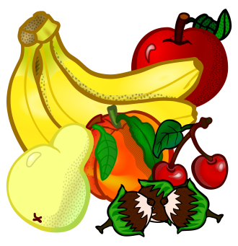
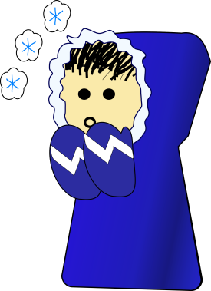
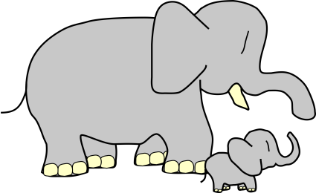
To Survive, Plants and Animals Need:
Food!
To Stay Cool or Warm!
Water!
Safety !
To Reproduce!
Openclipart.org: Fruits: Frankes; Water: Bibbleycheese; Girl: nlyl; Man in sun: hefedute; Elephants: TatsuoUeda; Warning :kg
Notes:
Safety can be safety from predators and also the terrain and elements. For example, Rough ground can injure soft feet. Dust blowing in the wind can injure eyes.

Slide 4
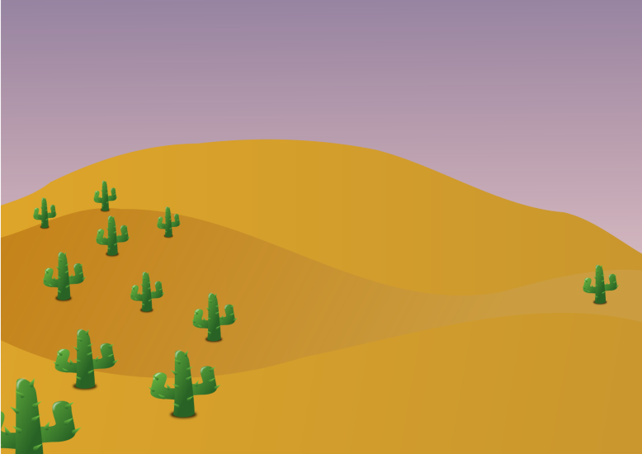
But traits that help animals in one habitat could hurt them in another habitat
Openclipart.org: beach: rg1024 (cropped); desert: hatso (cropped); Sun: bobby520; Snowy landscape: netalloy

Slide 5
This girl is wearing a warm jacket. Will the jacket help her or hurt her in the snow?
Openclipart.org: Snowy landscape: netalloy; girl: spevi
Notes:
It will hurt her – she could overheat. She will sweat in the jacket and could become dehydrated

Slide 6
What about at a hot beach?
Openslipart.org: beach: rg1024 (cropped); girl: spevi; Sun: bobby520
Notes:
It will hurt her – she could overheat. She will sweat in the jacket and could become dehydrated

Slide 7
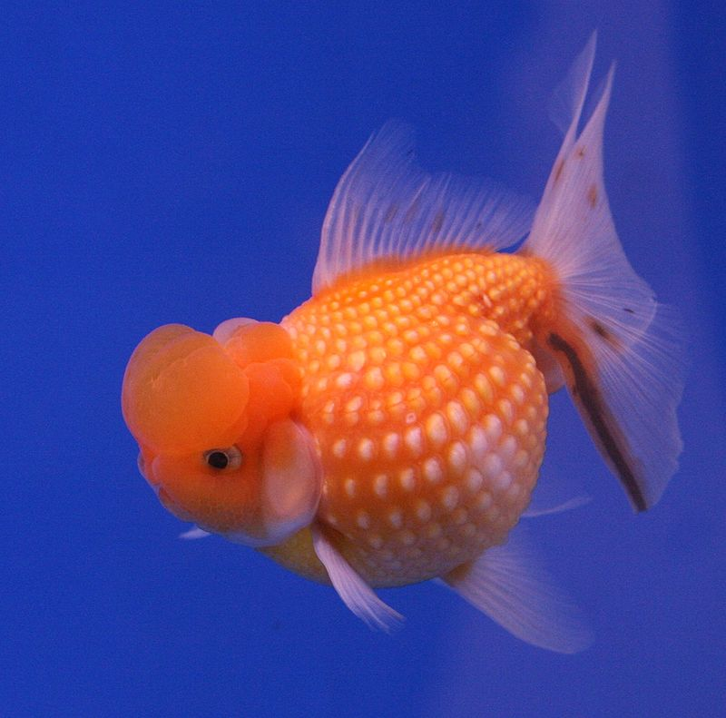
This goldfish swims nicely underwater
By Lerdsuwa - Own photo (400D + 50/1.4), CC BY-SA 3.0, https://commons.wikimedia.org/w/index.php?curid=1781691

Slide 8
What would happen if it got stranded on land?
By Lerdsuwa - Own photo (400D + 50/1.4), CC BY-SA 3.0, https://commons.wikimedia.org/w/index.php?curid=1781691; grass, openclipart.org, jbaldus; ; ; Sun: ; clouds, GR8DANbobby520

Slide 9
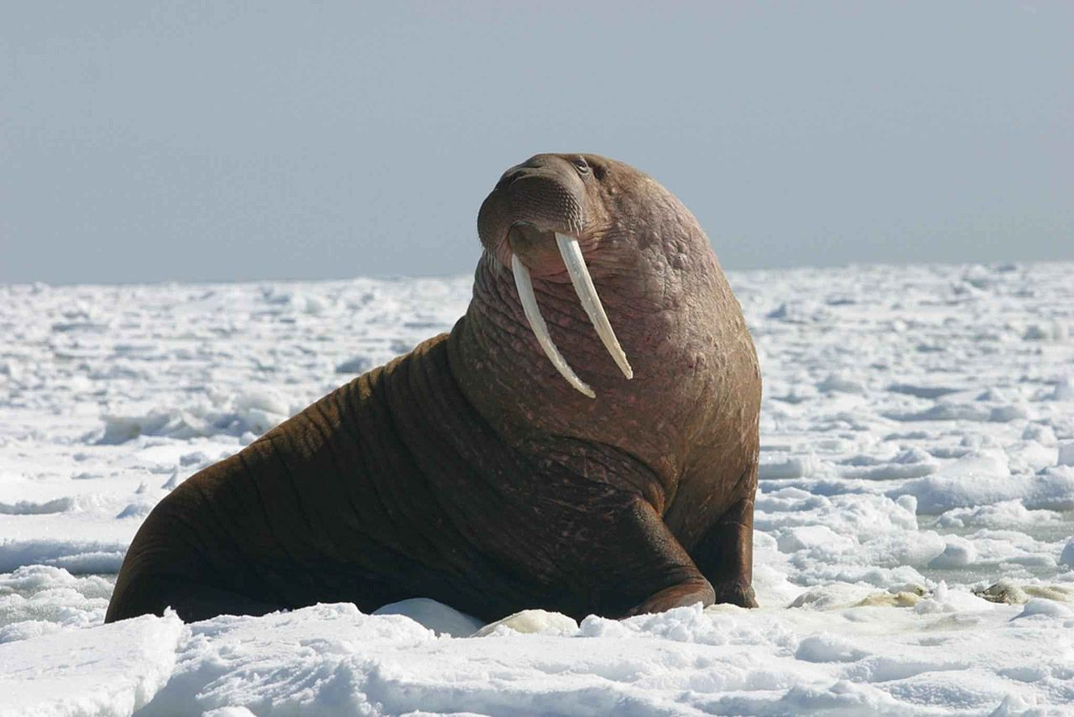
The thick blubber of the walrus helps keep it warm in cold environments

Slide 10
What would happen to the walrus if it lived in the hot desert?
Openslipart.org cactus: notKlaatu; Sun: bobby520;
Notes:
Animal would sweat!

Slide 11
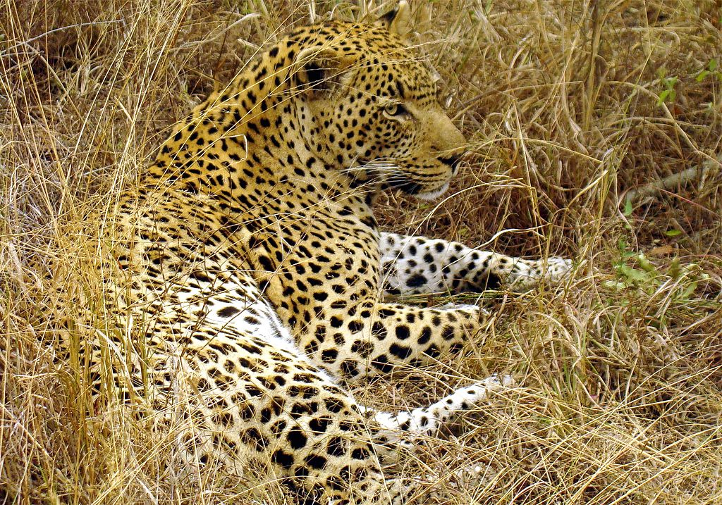
A leopard blends in well to tall grasses – this helps it hunt
By original by Lukas Kaffer (Super.lukas); crops and changes by JD - Image:Great male Leopard in South Afrika.JPG, CC BY-SA 3.0, https://commons.wikimedia.org/w/index.php?curid=2650050
Notes:
The leopard can avoid being seen by prey

Slide 12
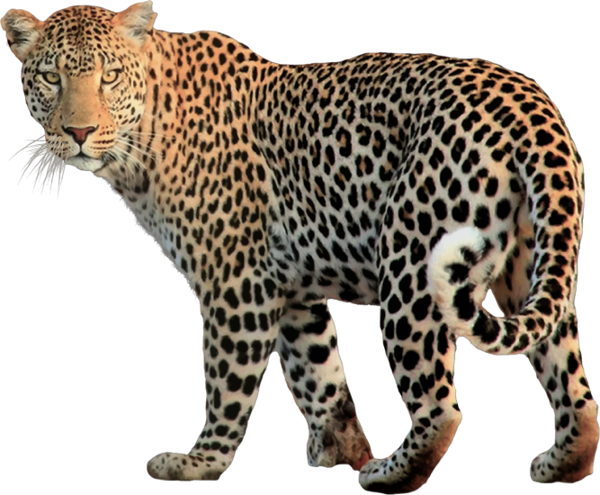
But a leopard would be easily spotted by potential prey in the snow.
Openclipart.org – Leopard by GDJ, snowy background by netalloy
Notes:
The prey would run away, causing the leopard to lose it’s dinner.

Slide 13
Which habitat better hides the leopard?
Notes:
The prey would run away, causing the leopard to lose it’s dinner. NOTE: There are Snow Leopards that are grey to yellowish with the dark spots. They tend to live in places that can be, but are not always covered in snow.

Slide 14
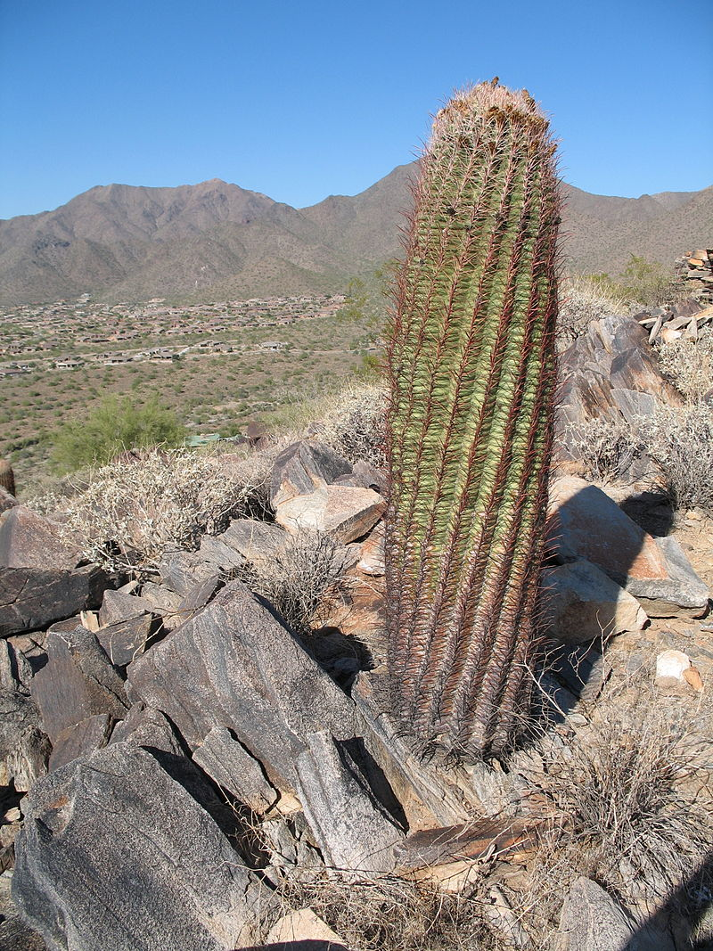
This cactus stores water and does well in a dry environment
Public domain from wikimedia commons
Notes:
The leopard can avoid being seen by prey

Slide 15
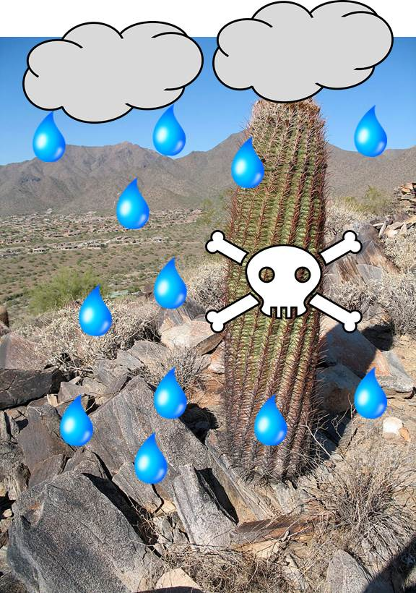
In a wet environment, this cactus would take TOO MUCH water and die
Openslipart.org water drops: lukeb: ;skull and crossbones: SOIvera ; clouds: barnheartowl
Notes:
The leopard can avoid being seen by prey

Slide 16
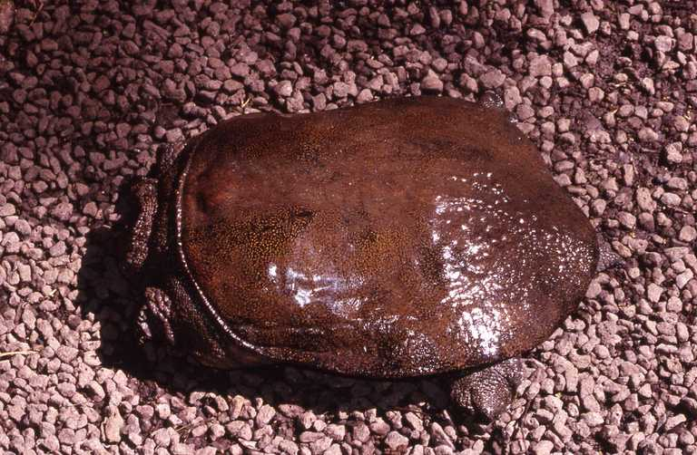
However, often species CAN survive in a new habitat, if it’s similar enough to their old habitat
By Simon J. Tonge - http://calphotos.berkeley.edu/cgi/img_query?enlarge=0000+0000+1212+1467, CC BY 3.0, https://commons.wikimedia.org/w/index.php?curid=26140531
Notes:
The leopard can avoid being seen by prey

Slide 17
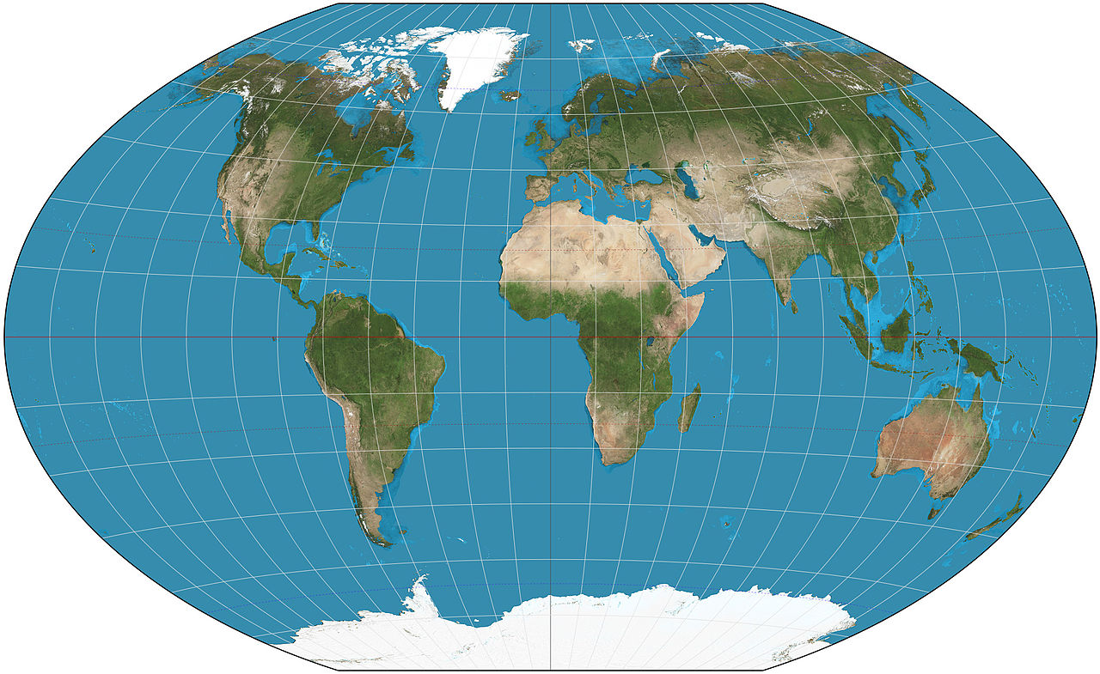
For example, the wattleneck softshell turtle was brought to Hawaii from China in 1850
By Strebe - Own work, CC BY-SA 3.0, https://commons.wikimedia.org/w/index.php?curid=16115375
Notes:
The leopard can avoid being seen by prey

Slide 18
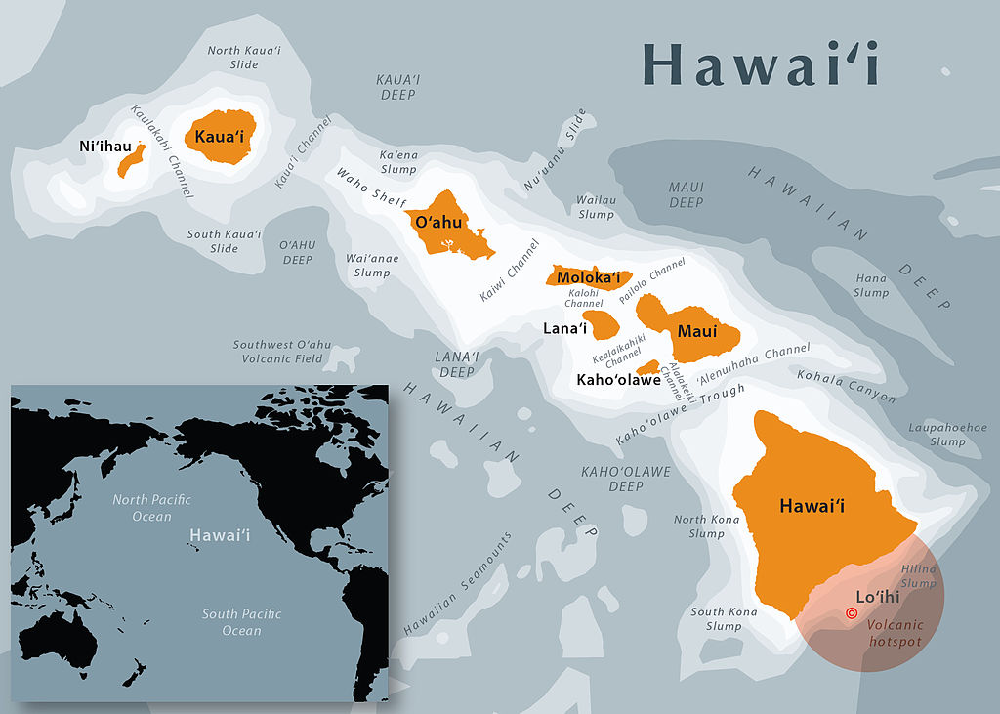
This turtle has thrived in Hawaii
Map of the main islands of Hawaii. UTM Zone 4N. Data sources: Natural Earth, Hawaii State GIS Program, USGS map "Hawaii's Volcanoes Revealed".
; By Simon J. Tonge - http://calphotos.berkeley.edu/cgi/img_query?enlarge=0000+0000+1212+1467, CC BY 3.0, https://commons.wikimedia.org/w/index.php?curid=26140531
Notes:
The leopard can avoid being seen by prey

Slide 19
Think of other animals and where they live. What if they lived somewhere else? Discuss with your partner
Notes:
Make sure to tell the class not ALL animals do poorly in new environments. Sometimes they do TOO well even – then they are call invasive species.

